Slide 1
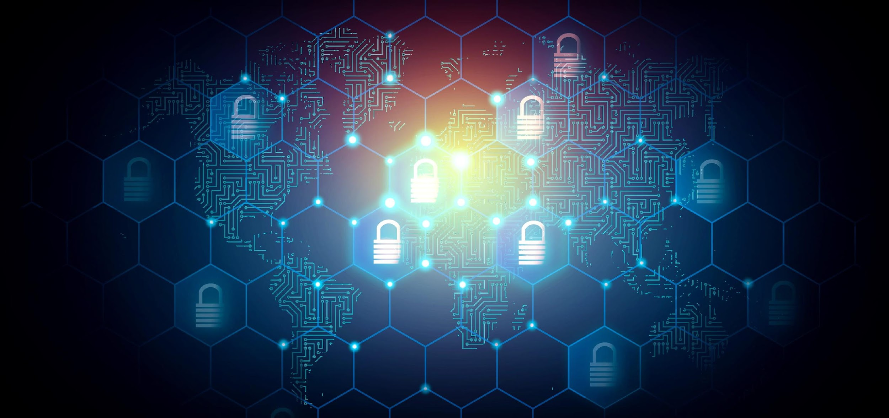
CIA Triad in Cyber Security
Notes:
Hello Everyone! Today My topic of Speaking is CIA Triad in Cyber Security. Before Moving towards topic let me introduce myself,…………(Next Slide).

Slide 2
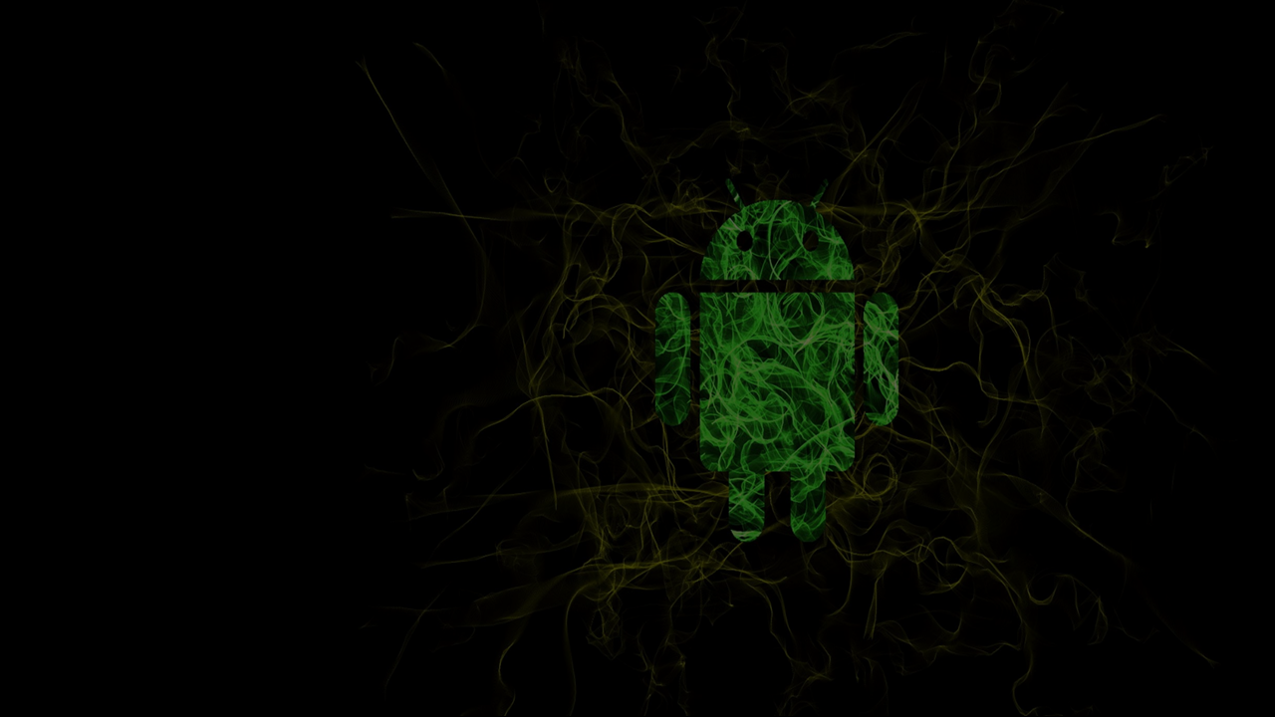




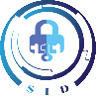



🡺 Presenter Details:
Hassan Zaib Jadoon, (Abbottabad) .
Student of “Computer System Engineering” at “University of Engineering & Technology, Peshawar”.
Currently working as “Undergraduate Researcher” at “SID (Secured IOT Devices) Lab
Hassan Zaib Jadoon
Social Media Handles
Hassan Zaib Jadoon
Hassan Zaib Jadoon
. hassanzaibjadoon2004
Notes:
Myself Hassan Zaib Jadoon, A student of Computer System Engineering at University of Engineering & Technology, Peshawar. Basically, I am from Abbottabad. Currently I am working as a Undergraduate researcher at “SID Lab” which is located in UET Peshawar. That’s all my short intro, for more You can Visit my Social Media Platform for more information. Lets move to the Table of Contents of the presentation………Next Slide,

Slide 3

Table of Contents
History of CIA Triad.
Anderson Report as Foundation of CIA Triad
Bell-La Padula Model
Biba Model
Denning Intrusion-Detection Method.
Confidentiality, Integrity, & Availability.
References.
Notes:
Here You can see the Table of Contents and in These you can See the topics I discuss with you today, The Number First Is ”History of CIA Triad,
Second Number is Anderson Report as Foundation of CIA Triad, Third one is Bell-La Padula Model, Fourth one is Biba Model,
Fifth one is Denning Intrusion-Detection Method,
And in the Last Detail Discussion about CIA and Then Reference and Conclusion, Let’s Move to the History Slide…….. Next Slide Plz

Slide 4


History of Confidentiality, Integrity & Availability Triad
Computer Invention
?
Securing Device Physically
Computer’s Prices
Knowledge & Usage
Time
Start Focus on Securing Information
Knowledge & Usage
Computer’s Prizes
Which type of data They wanted to Secure?
Notes:
The first Computer was invented in between 1833-1871. ( An analytical Device that was powerful enough to perform simple Calculations).
In starting age of computers, there were only a few threats to Data Because,
Computers were expensive and rare.
Information will be only exposed to limited number of peoples who know programming and Usage of Computer.
So they Secure Computer’s Devices Physically.
🡺🡺🡺🡺🡺But With the Passage of time Knowledge & Usage of Computers Increased And Also Computer prizes Decreased, so Everyone will be able to access data, So they think about securing information so CIA Triad will gain Importance. Before going forward, It’s a Common Question what they wanted to secure……………..
According to JISSEC article this is deeply related to military security mindset (Agencies) and Governmental Information, That’s the reason Anderson & other reports focused on Military/governmental Information.

Slide 5

Anderson Report as Foundation of CIA Triad
This Report was formulated by United States Air Force, identify the three risks of potential security, which are basically the foundation of CIA.
Unauthorized Information Release (Confidentiality)
Unauthorized Information Modification (Integrity)
Unauthorized Denial of use (Availability)
An unauthorized person is able to read and take advantage of information stored in the computer.
An unauthorized person is able to make changes in stored information.
Intruder can prevent an authorized user from referring to, or from modifying information, even though the intruder may not be able to refer to, neither modify the information themselves.

Slide 6

Bell-La Padula Model
Bell and La Padula, 1975
Provides Confidentiality
Based on grating Access to those who need to know
Three Main Rules
No Read up
No write down
Read/Write only at same level

Slide 7



Biba Model and Denning Intrusion Detection Model
Biba, 1975
Denning, 1987
Focused on Data Integrity
This model is based on the hypothesis that security violations can be detected by monitoring a system's audit records for abnormal patterns of system usage.
Goals consist of No Data Modification
Many of these models were developed in partnerships between government and/or military agencies and academics;
Notes:
The goals of the Biba Integrity Model are
To prevent data modification by unauthorized parties,
To prevent unauthorized data modification by authorized parties, & to maintain internal and external data consistency.
More specifically, confidentiality, integrity and availability are seen as goals through which information security is achieved

Slide 8

Confidentiality:
Confidentiality is a fundamental principle of information security that ensures sensitive and private information is protected from unauthorized access, use, or disclosure.
Confidentiality extends to various types of information, including personal data, financial records, intellectual property, trade secrets, and classified government information.
Multifactor Authentication will be used to achieve Confidentiality.
Examples of Confidentiality are as Fallows:
Doctor-Patient Confidentiality.
Data Privacy Regulations (Governmental Data/General Data of Companies).
Personal Passwords and PINs.
Banking and Financial Information.
Research Data etc.
Four Types of Confidential Data That Must Be Protected:
PII ( Personally Identified Information )
CCI ( Company Confidential Information )
CCI ( Customer Confidential Information)
PHI ( Protected Health Information )
Notes:
The information is accessible only to those authorized to view it.
Breaches of confidentiality can lead to severe consequences, including legal liabilities, financial losses, and damage to reputation.
The two-factor authentication (debit card with the PIN code) provides confidentiality before authorizing access to sensitive data.
Camp (1999) posits that confidentiality implies the notion that data and the information represented by such data must be protected; in such a way that its use is confined to authorized purposes by authorized people only.

Slide 9
Integrity:
Integrity is a core principle of information security that focuses on maintaining the accuracy, consistency, and trustworthiness of data throughout its lifecycle.
Ensuring the integrity of data is essential for maintaining trust with customers, stakeholders, and users who rely on accurate information.
Email frauds attacks can disturb the integrity of communications.
Examples of Integrity are as Follows:
Financial Transactions.
Secure Software Updates etc.
The ATM and bank software ensure data integrity by maintaining all transfer and withdrawal records made via the ATM in the user's bank accounting.
Notes:
The information is accurate and trustworthy. The goal of Integrity is to protect information from unauthorized modification.

Slide 10
Availability:
Availability is derived from Latin Word which mean worth (Time), In Internet Security Its means Timely and Reliable Access and use of Information.
The information is accessible and usable by authorized individuals whenever needed.
For achieving availability, we can uses a fault tolerance, Disk Redundancies, Server, Load and Site Redundancies, Backups, we can use alternate power (Uninterruptible Power supplies) and Cooling Systems for improving Availability of system.
Ransomware attacks, Denial of Services will be Considered as an Attack for Disturbing Availability.

Slide 11
References:
Some Data is taken from paper of JISSEC: "The CIA Strikes Back: Redefining Confidentiality, Integrity and Availability in Security", by Spyridon Samonas and David Coss.
Link of PDF File (Click Here)
Some information is taken from Google Searches.

